Slide 1


Introduction To Visual Studio Code
BerryHub

Slide 2
Installation

Slide 3
Installing Visual Studio Code In your system
Navigate to the Original Website:
https://code.visualstudio.com
Select Appropriate Operating System
Start Downloading

Slide 4
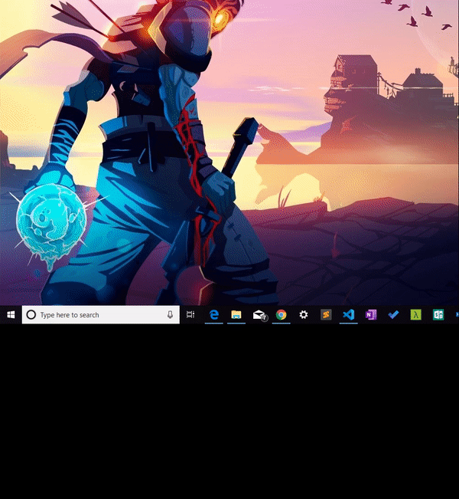
Creating Your First Project
Search for "VS Code" in your system
Then Open the App

Slide 5
What's Next?
Your Ideas Your Editor

